Slide 1
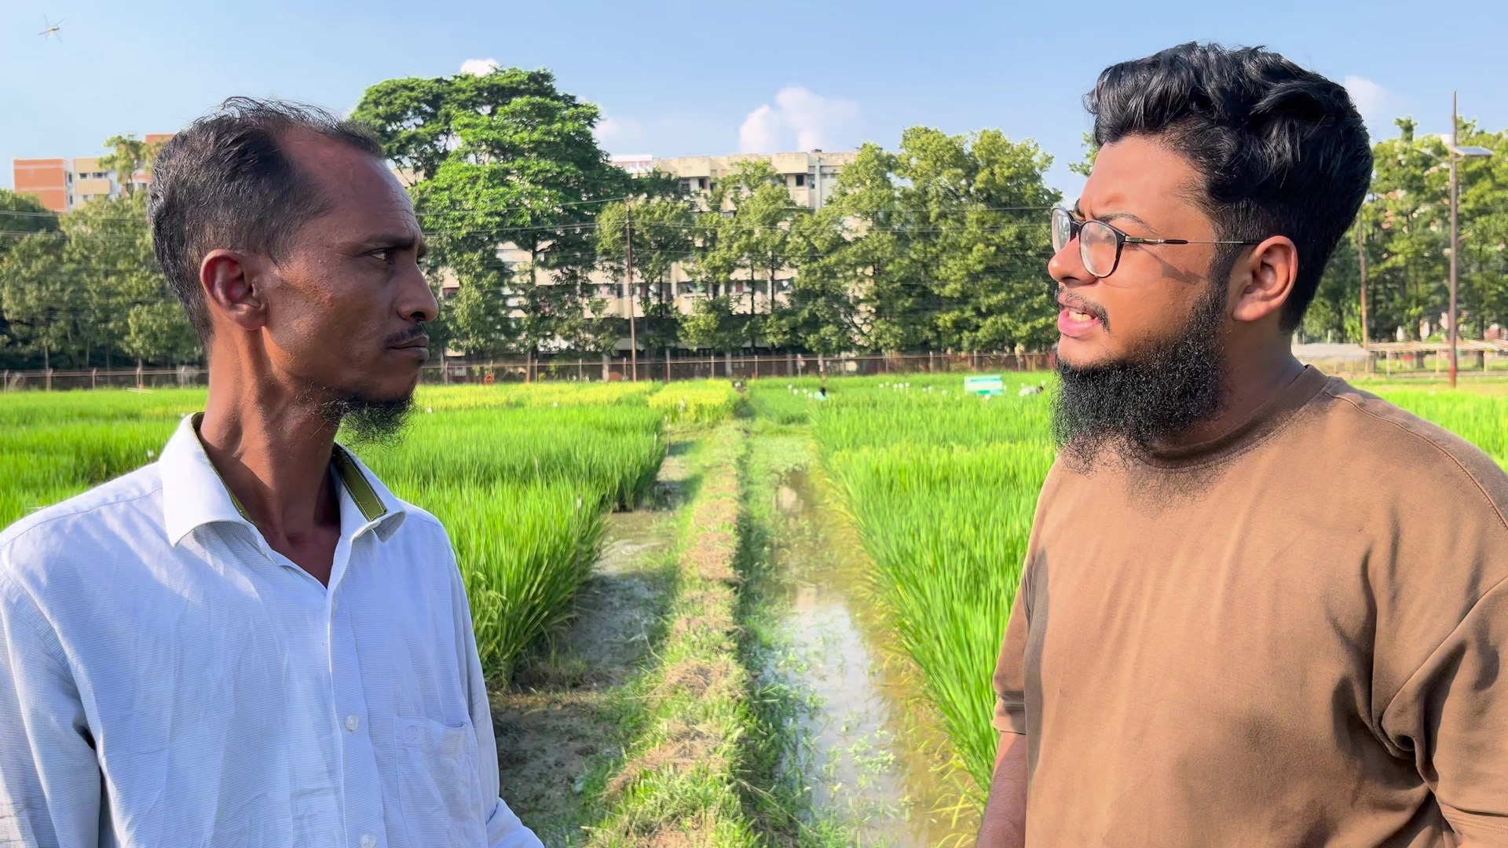
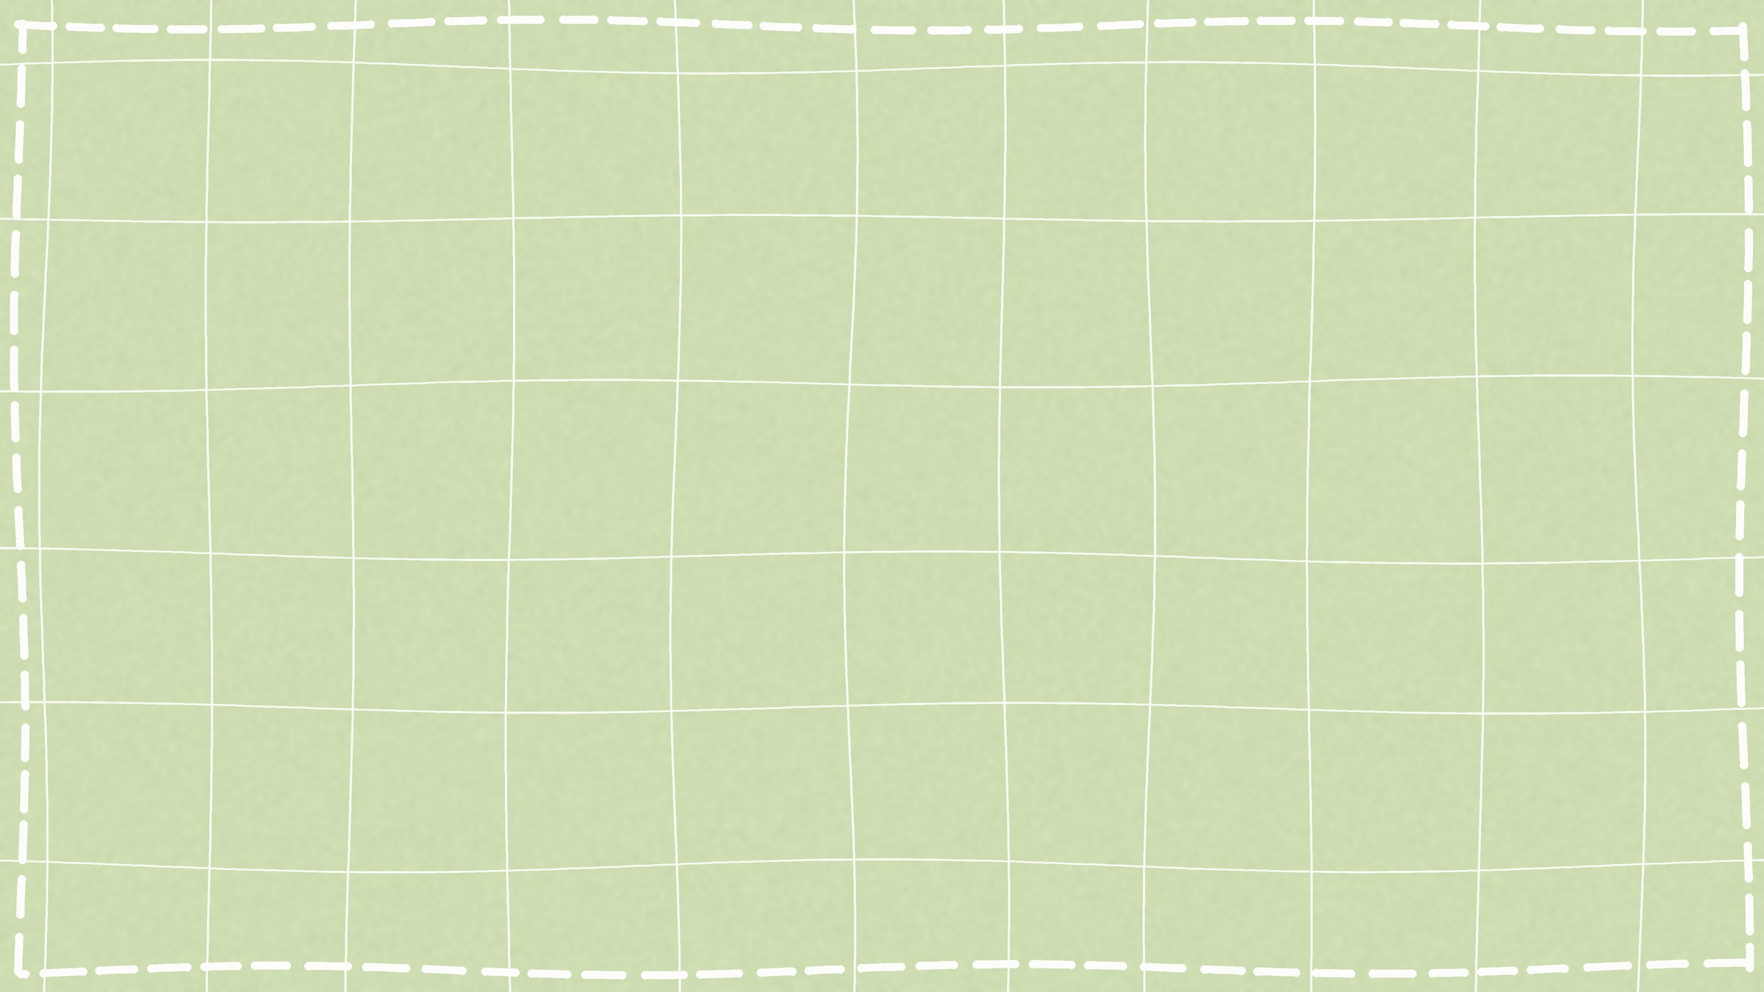
HE IS NOT ALONE · THE SAME STORY, SEASON AFTER SEASON
He grows the crop. Someone else gets paid for waiting.
FEB 2025 · BUSINESS STANDARD
APR 2025 · BDNEWS24
OCT 2025 · THE DAILY STAR
JUL 2026 · DHAKA TRIBUNE
Farmers strain under losses, selling potatoes at half the production cost
Surplus potatoes, empty pockets
Potato farmers left in the lurch as prices crash
Potato farmers protest cold storage rent hike in Rangpur
৳7–9 a kg at the farm gate, against a ৳17.26 cost.
Cold storages full; farmers say middlemen bought the booking slips in advance.
৳8 a kg wholesale, half the cost. Unsold sacks pass to the cold storage after 15 November.
Rent up to ৳450 a sack while potatoes sell at ৳14–15 a kg, against a ৳25–26 cost.
KrishiVault makes sure the farmer can wait.
STUDY
BRAC UNIVERSITY · 2016 FIELDWORK
STUDY
HAJONG AND OTHERS · RANGPUR · 2014
Farmer ৳480 → retailer ৳819
Why farmers can't store
for the same 40 kg in Bogura and Munshiganj, with several traders in between. Study-period prices, not today's.
High cold-storage charges, an uncertain future price and no money. Prices bottom at harvest and peak in December.
Notes:
[0:00-0:55 · Speaker A]
DO: The slide opens and the clip plays by itself (34 s, English subtitles). Say nothing and do not click while it plays: a click jumps to slide 2. When it ends, the caption fades in, then seven cards (four news reports, two studies, our promise), one by one. Start speaking as the first card appears. Test the sound on the venue laptop.
SAY (after the clip, as the cards come in):
"He grows the crop. Someone else gets paid for waiting.
And he is not alone. February 2025: farmers selling at half their cost. October: prices crash, and unsold sacks pass to the cold storage. This July: rents up again.
Research has said it since 2014: high rent, an uncertain price, no cash.
We are KrishiVault, and we make sure the farmer can wait."
IF THE VIDEO FAILS: hold up a button phone. "This is the only device the farmer in our story owns. Everything we show you today works on it." Click once: the cards still appear.
THE CARDS (all opened and checked on 16 October 2026):
- The Business Standard, 13 Feb 2025, "Farmers strain under losses, selling potatoes at half the production cost": farm gate ৳7-9 a kg; cost ৳17.26 (Department of Agricultural Marketing).
- bdnews24, 23 Apr 2025, "Surplus potatoes, empty pockets": record area, cold storages full; farmers allege middlemen bought storage booking slips in advance (a manager denied local farmers were displaced).
- The Daily Star, 15 Oct 2025, "Potato farmers left in the lurch as prices crash": ৳8 a kg wholesale; DAE cost in the north ৳14.5-16; after 15 November unsold stock passes to the cold-storage owners.
- Dhaka Tribune, 1 Jul 2026, "Potato farmers protest cold storage rent hike in Rangpur": rent raised to ৳450 a 50-kg sack; potatoes at ৳14-15 a kg against a ৳25-26 cost.
- BRAC University value-chain study (Bogura, Munshiganj; 2016 fieldwork): farmer ৳480.38, retailer ৳818.50 per 40 kg. Study-period prices; the gap also pays transport, labour and losses, so never call it all trader profit.
- Hajong, Moniruzzaman, Mia, Rahman (2014), "Storage System of Potato in Bangladesh", Universal Journal of Agricultural Research 2(1): Rangpur, 10 cold storages, 20 traders, 30 farmers; farmers cannot use cold storage because of high charges, an uncertain future price and financial insolvency; prices lowest at harvest, peak in December.
ABOUT THE CLIP: our own field interview, recorded 14 October 2026 (cut from presentation material/IMG_4781.MOV; cuts and subtitles in scripts/pitch_deck/hook_cuts.json). He grows potatoes, maize and rice; uses a button phone and cannot read SMS; sells at the haat and "never makes the money we should"; "some years profit, some years loss". Do not name him without his consent.

Slide 2



The price rise is real. It never reaches the farmer.
THE PROBLEM · 11.6 MILLION TONNES OF POTATO A YEAR
64%
97.6%
≈ 2×
৳20–25
of the harvest is sold right away, at the season's lowest price ¹
of cold-stored potatoes are bought by traders, not farmers ¹
shop price after a normal crop: ৳35 in Feb, ৳67.50 by Nov 2024 ²
all through 2025, after a big crop: storing lost money ²
The cash trap
The flat-rent trap
The blind-bet trap
Loans and the trader's advance (dadon) fall due at harvest. He must sell now, at the year's lowest price.
About ৳300 a sack for 1 month or 9. Afraid of a fall, he sells after 1 to 3 months, having paid for 9.
Crop size sets the price: 2024 doubled, 2025 stayed flat. Nobody tells him which kind of year it is.
Debts due on day 1
৳300 a sack, 1 month or 9
−৳25,280 storing 36 sacks in 2025
A price alert does not pay today's debt. Traders have the cash, the sums and the information to wait. The farmer has none.
¹ Value-chain study, Kahaloo (Bogura) and Munshiganj, 2016 fieldwork. ² WFP retail prices (HDX); the 2025 loss is our engine's replay. Production: BBS 2024-25.
Notes:
[0:55-1:35 · Speaker A]
SAY:
"Every March, a potato farmer asks one question: store or sell, and until when?
After a normal crop the shop price nearly doubles. Yet farmers sell 64 percent at harvest, and traders buy almost all that goes into cold storage.
Three traps hold him. Cash: loans and the trader's advance fall due the week he harvests. Flat rent: 300 taka a sack for one month or nine, so fear makes him pay for nine and sell after two. And a blind bet: 2024 doubled, 2025 never rose. Nobody tells him which year it is.
A price alert does not pay today's debt."
IF ASKED:
- "The study is from 2016?" Yes, and we say so. Today's prices and production are our own data (WFP 2024-26, BBS 2024-25), and the 2025 news shows the same pattern.
- "Why retail prices?" WFP publishes retail; farm-gate moves with it. Real farm-gate history is on our data list.
- "The news says ৳450 a sack, you say ৳300?" ৳300 for an 84-kg sack is the plan's figure; rents differ by district and sack size and are rising. Every cost is editable in the engine, and the field check sets this season's.

Slide 3

One service that answers each trap
WHAT KRISHIVAULT IS · KNOW · CALCULATE · DECIDE · ACT
KrishiVault is a voice-first service for potato farmers. It tells him how many sacks to sell now and how many to store, until when, and lets a bank lend against the stored sacks, so he can afford to wait.
THE TRAP
KRISHIVAULT'S ANSWER
FOR
The cash trap
Debts fall due at harvest
Cash without selling
A bank lends against a digital cold-storage receipt in his name.
Smallholder potato farmers. First in Kahaloo, Bogura.
THROUGH
The flat-rent trap
Pays for 9 months, sells in 2
The sums, sack by sack
Sell how many now, store how many, until when: after rent, 8.65% loss and interest.
Grameenphone voice line, USSD and SMS. Cold storages and banks use the web.
PAID BY
The blind-bet trap
Can't tell a 2024 from a 2025
An outlook with a range
Driven by crop size; in a glut year it says "sell now".
Cold storages, banks and buyers. Never the farmer.
NEVER
He can't read an SMS
From our field interview
A Bangla voice call
Two numbers on any button phone; USSD and SMS as well.
Lends or holds money, or sells a place in the advice.
Notes:
[1:35-2:10 · Speaker A]
SAY:
"So what is KrishiVault? A voice-first service for potato farmers. It tells him how many sacks to sell now and how many to store, until when, and lets a bank lend against the stored sacks, so he can afford to wait.
Every trap gets an answer: cash without selling, the sums sack by sack, an outlook with a range, and a voice call, because he can't read an SMS.
Farmers never pay. Cold storages, banks and buyers do."
HAND OVER: "B will walk you through one season."
IF ASKED:
- "Isn't this just another agri app?" No app: a voice call, USSD and SMS on any phone, and the cash through a bank. An app gives information; information without cash changes nothing at harvest.
- "Do you give loans?" No. The bank decides and pays; we verify, value and connect, and never hold money.

Slide 4






One call turns a harvest into a plan, and the cash to wait
HOW IT WORKS · ONE FARMER, ONE SEASON
1 Call
2 Decide
3 Vault
4 Cash
5 Sell
He calls or dials USSD with two numbers: sacks harvested, cash needed now.
The engine answers in taka: sell 19 sacks now, store 17 until December.
The cold storage weighs the sacks and sends a digital receipt by SMS, in his name.
A bank lends against the receipt and holds the sacks. No forced sale today.
A price alert, by call or SMS, says how many sacks to sell and to whom. The sale pays storage, bank, then him.
SEVEN PARTS, ONE LOOP
HIS SEASON, IN TAKA (36 SACKS)
Price and crop outlook
Store-or-sell engine
Crop-backed loans
Buyer matching
৳25,020 in hand today: the cash he needed
Net profit ৳12,940 on average, not ৳5,610
Bad case said aloud: −৳4,970 (1 in 10)
Group storage and selling
Export intelligence
Profit calculator
Notes:
[2:10-2:40 · Speaker B]
SAY:
"One farmer, one season. He calls with two numbers: 36 sacks, and 25 thousand taka needed this week.
The engine answers: sell 19 now, which covers his 25 thousand; store 17 until December. Net profit about 13 thousand, not five and a half.
The cold storage issues a receipt in his name; a bank lends against it.
When the price is right, an alert says how many to sell and to whom. The sale repays the storage, then the bank, then him."
IF ASKED:
- "Where do these numbers come from?" The engine, with the plan's costs (৳300 rent, 8.65% weight loss) and a ৳14 a kg growing cost (DAE Bogura 2024-25); the farmer's own figures replace them.
- "Won't partner fees bias the advice?" No paid placement: buyers are ranked by money left in the farmer's hand.

Slide 5




AI listens and speaks Bangla. Exact sums decide.
AI AND TECHNICAL RATIONALE · LIVE DEMO
UNDERSTAND
DECIDE
SPEAK
AI
statistics + exact sums
AI, under a lock
Google Bangla speech-to-text
Our parser reads dialect: মণ, বস্তা, টেকা
Gemini fills gaps; every number must have been said
Price outlook driven by crop size (BBS + WFP)
2,000 simulated price paths, always a range
Rent, 8.65% weight loss, interest, net profit
Bangla answer from the engine's numbers
Number lock: any changed figure is thrown out
Google Bangla voice, SMS, keypad always works
WHY THIS DESIGN
LIVE NOW · CLICK TO OPEN
He can't read an SMS: voice first, in his dialect; the keypad always works.
Money must be exact: a language model never sets a taka figure.
The future is uncertain: ranges from simulated paths, not one price.
Price data is thin: ML (XGBoost, LSTM) only once 15 years of DAM prices are backtested.
koryu.ninja
Dashboard, voice call, USSD menu, real SMS and phone call. 160 tests pass.
Notes:
[2:40-4:05 · Speaker B · about 35 s talk, then a 50 s demo]
SAY:
"The farmer in our video can't read an SMS, so KrishiVault starts with his voice.
AI where language and uncertainty live; fixed rules where money lives.
AI listens: Google's Bangla speech and our own dialect parser. Gemini only fills gaps, and every number must have been said.
The decision is statistics and exact sums: 2,000 simulated price paths driven by the crop size, then rent, weight loss and interest.
AI speaks under a number lock: change one figure and the answer is thrown out.
It's live. Let me show you."
DEMO (click koryu.ninja, about 50 s):
1. Top bar: "Live Voice Call". Press the first "Try" sentence: "হামার ৮০ মণ আলু উঠছে, ফড়িয়া ১৬ টেকা দিবার চায়, ২৫ হাজার টেকা নাগবে ৪ দিনের মইধ্যে". Say: "Dialect, understood; every number read back."
2. Press 1. The answer: "Sell 19 sacks now, store 17 until December." Say: "It also tells him the bad case. Nobody else tells a farmer that."
3. Press 2 (cold-storage request) or send the SMS / place the phone call to a teammate's phone.
4. If time: USSD preview, ask a judge for two numbers.
FALLBACK: the screen recording in a second tab; if anything stalls 5 s, switch without comment.
Back to the slides with Alt+Tab.
IF ASKED:
- "Why not deep learning?" Two seasons of clean prices: XGBoost or LSTM would overfit. They come once 15 years of DAM prices are loaded and they beat today's outlook on past seasons.
- "Which AI exactly?" Google speech-to-text and text-to-speech (Bangla), Gemini Flash for understanding and rewording; the outlook is a statistical simulation; the decision is deterministic.
- "Can the AI get a number wrong?" It cannot reach the farmer: numbers must have been said on the way in, are read back for a keypad yes, and the number lock checks every figure on the way out.
- "Is it a chatbot?" No, a guided call: it asks only what it needs, reads it back, answers in taka with the risk.

Slide 6
Tested on two real seasons it had never seen
PROOF · FAIR REPLAYS, NO HINDSIGHT
MARCH 2024 · NORMAL CROP
MARCH 2025 · BIG CROP
PRICE OUTLOOK BACKTEST
“Sell 11 sacks, store 25 until December”
“Sell now.”
11%
Storing all 36 sacks would have lost up to
average price miss, against 52% for the usual seasonal pattern
2.5×
৳25,280
92%
net profit, after the ৳14 a kg growing cost
and at least ৳17,110, whichever month he sold. The advice kept that loss out of his pocket.
of months inside its 8-in-10 range
2 of 2
An advisor that says “don't store” when storing loses is one a farmer can trust.
store-or-sell calls right
Engine replays: 36 sacks, ৳300 rent, 8.65% weight loss, ৳14/kg growing cost (DAE Bogura 2024-25), WFP retail prices. Two seasons is a first test, not proof: next, 15 years of DAM prices.
Notes:
[4:05-4:40 · Speaker B]
SAY:
"Does it work? We replayed two real seasons with only what was known at harvest.
2024, a normal crop: sell 11, store 25. Net profit two and a half times higher.
2025, a big crop: sell now. Storing would have lost up to 25 thousand taka. An advisor that says 'don't store' is one you can trust.
The outlook missed by 11 percent, against 52 for the usual seasonal pattern. Two seasons is a first test, not proof."
IF ASKED:
- "Two seasons: why trust it?" We don't ask you to. It gives a range, shows the bad case, never bets the whole crop on one month (30-40% sold at harvest), and in a glut year banks lend at most 50%.
- "Storing everything in 2024 would have made more?" Yes, about 3.4 times, but nobody could know that in March. Our rule never bets the whole crop.

Slide 7







Others solve one piece. KrishiVault closes the loop.
WHY KRISHIVAULT · DIFFERENTIATION AND DEFENSIBILITY
Traders
Price apps
Banks, MFIs
KrishiVault
WHY IT IS HARD TO COPY
Cash at harvest without selling
The loop is the product
buys at the low
wants land
loan on the receipt
Sums, receipt, loan, alert, split at sale. One piece alone does not break the trap.
Price outlook, 1 to 9 months
Both sides are paid to stay
keeps it private
today's price
with a range
Cold storages fill space; banks get stock they can check.
Store-or-sell sums after every cost
per sack, in taka
Trust built into the code
Verified stock in cold storage
Ranges, the bad case said aloud, the number lock.
holds 97.6%
can't check it
digital receipt
Works on a button phone, in Bangla
Data that compounds
in person
smartphone
branch visit
voice, USSD, SMS
Every consented call adds district data nobody else has.
Warehouse-receipt lending already lets farmers wait in India (Arya.ag). Bangladesh has the cold storages; KrishiVault adds the sums, the receipt and the phone.
Notes:
[4:40-5:10 · Speaker B]
SAY:
"Traders give cash, but at the harvest low. Price apps give a price, but no cash. Banks have cash, but can't check a farmer's potatoes.
Only KrishiVault closes the loop, and that is hard to copy: cold storages and banks both earn by staying in it, and every consented call adds data nobody else has.
Receipt lending already lets farmers wait in India. Bangladesh already has the cold storages."
IF ASKED:
- "Why would cold storages join, when early turnover helps them?" Group bookings fill space early, verified receipts bring them loan customers, fees are collected at the sale, and we track only our tagged sacks, not their books.
- "Why would banks lend against potatoes?" A named, weighed receipt from a verified cold storage, sacks held for the bank, valued at the low price after the 8.65% loss, and the sale repays the bank first.

Slide 8
Pilot in Kahaloo next harvest. Break even in year two.
EXECUTION · SCALE · BUSINESS MODEL
PHASE 1 · MONTHS 1–4
PHASE 2 · MONTHS 5–12
PHASE 3 · YEAR 2 ON
Kahaloo, Bogura
Bogura + Munshiganj
National
50–100 farmers, 1–2 cold storages, 1 lender. First 100 tonnes of crop-backed loans.
1,000+ farmers, 10 cold storages, group storage and buyer lots.
Rangpur, Dinajpur, Cumilla, Thakurgaon. Onion and maize; export market.
WHO PAYS: NEVER THE FARMER
PROJECTION, ৳ LAKH
TO START
Cold storage
4% of rent
৳12 / sack
৳20 lakh
Bank or MFI
1.5% of loan
৳4.50 / sack
Year 1: 2,000 farmers, 5 cold storages
Break-even: month 14–16
No storage to build, no money lent
Buyer
1% sourcing fee
≈৳12 / sack
Grameenphone
call revenue share
≈৳30 / farmer
Govt, media
glut and stock data
subscription
Notes:
[5:10-5:45 · Speaker C]
SAY:
"Next harvest we start in Kahaloo, Bogura: 50 to 100 farmers, one or two cold storages, one lender. Then Bogura and Munshiganj, then the country, with onion next.
Farmers never pay a fee. Partners pay only when they gain: 4 percent of the rent from cold storages, one and a half from banks, 1 from buyers, and a share of the voice line with Grameenphone.
20 lakh taka runs the first year. We project break-even around month 15, and the pilot tests it."
IF ASKED:
- "Who are your partners?" The prototype uses demo partners, labelled. BKB, BRAC, PKSF, Himadri and PRAN are organizations we will approach, not partners yet.
- "What could kill this?" Partners refusing the fees. The pilot measures it: price received against neighbours, loans used instead of early sales, and repayment.

Slide 9




When farmers can wait, the whole chain gets fairer
IMPACT · AI FOR SOCIAL GOOD
FARMER INCOME
AT SCALE
FOOD AND RESILIENCE
GOVERNMENT
2.5×
৳118 crore
Less waste
Stock it can see
net profit in a normal year (2024 replay), and no storage loss in a glut year
more to farmers in a normal year at year-3 scale: 2.4 million sacks × ৳492 (an illustration, not a forecast)
curing reminders, generator-backed storage, and no storing into a glut year
a glut warning from crop data, receipts with a name, district figures from farmers who agree
Built for farmers like the one in our video, who can't read an SMS: a voice call in his own dialect, a two-number USSD menu. Any button phone, no internet.
Notes:
[5:45-6:15 · Speaker C]
SAY:
"For one farmer: two and a half times the profit in a normal year, and no storage loss in a glut.
At year-three scale, about 118 crore taka more to farmers in a normal year. An illustration, not a forecast.
Less food wasted, because nobody stores into a glut. And stock the government can finally see, with the farmer's consent.
All on a button phone like his, in his own dialect."
IF ASKED:
- "If every farmer stores, won't the rise disappear?" Partly, and that is the point: the gap shrinks and moves to farmers, and consumers see smoother prices. We never advise the whole crop, and the government screen watches stored stock.
- "Privacy?" Counted only after the farmer presses 8; no names or numbers; districts with fewer than 5 farmers are hidden.

Slide 10
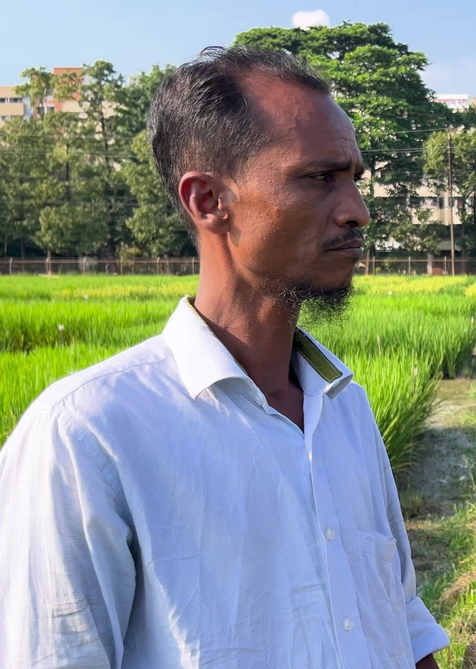
NEXT MARCH
He will ask the same question. This time he gets the sums, the cash to wait, and a receipt with his own name on it.
আলু রাখবেন না বেচবেন, কবে বেচবেন:
হিসাব করে বলে কৃষিভল্ট।
Store or sell, and until when: KrishiVault does the sums.
OUR ASK
Help us open the first cold storage and the first lender in Kahaloo, on Grameenphone's voice line.
Our field interview, October 2026
Try it: koryu.ninja
Notes:
[6:15-6:35 · Speaker A; about 20 s spare]
SAY:
"Next March, he will ask the same question. This time he gets the sums, the cash to wait, and a receipt with his own name on it.
আলু রাখবেন না বেচবেন, কবে বেচবেন: হিসাব করে বলে কৃষিভল্ট।
Help us open the first cold storage and the first lender in Kahaloo. Thank you."
Q&A RULES (3 minutes): the answer in the first sentence, one number, under 25 seconds, then bridge back to something they saw. If we don't know: "We don't know yet; the pilot measures it this way." Never argue. Full playbook: docs/presentation_plan.md.

